Slide 1
FASD United
September 2023
Policy Forum
Policy & Training Center
Program Contact: Jenn Wisdahl
wisdahl@FASDUnited.org
202-601-2530
Chris Melfi
Melfi@fasdunited.org
Wednesday
September 27th, 2023

Slide 2
Organization Update

Slide 3
Thank You!!

Slide 4
Web Resources and Tool Kit Now Available on FASDUnited.org

Slide 5
9th International Research Conference on
Adolescents and Adults with
Fetal Alcohol Spectrum Disorder
Review, Respond and Relate
Integrating Research, Policy and Practice
Around the World
Coming to its new home in Seattle
April 11-14, 2024
A project of The ALC FASD Changemakers and
FASD United
THE NATIONAL VOICE ON FETAL ALCOHOL SPECTRUM DISORDERS
Formerly NOFAS

Slide 6
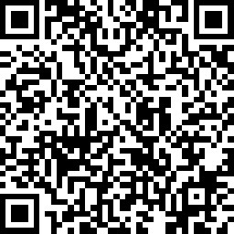
Run FASD

Slide 7
FASD Respect Act 2.0
Bill Contents
Education, Awareness and Services across community agencies
Building State and Tribal Systems
Centers for Excellence

Slide 8
Pathway to Law
July
Step 1
The Bill is Drafted with Input from Key Stakeholders
Step 3
Draft Bill Vetted through House and Senate Legal Council
Step 4
Bill is Introduced and Assigned a Bill Number
Step 5
Bill is Heard in Committee
Step 7
Bill is Voted On
Step 6
Bill is Sent to the Floor
Step 9
Bill is Sent to the President for Approval into Law
Step 8
Bill is Referred to Senate/House for Conference Approval
Step 2
Draft Bill Reviewed by Agencies, Local Constituents
April
May
June
August
September
The 118th Congress Lasts for 2 years.

Slide 9
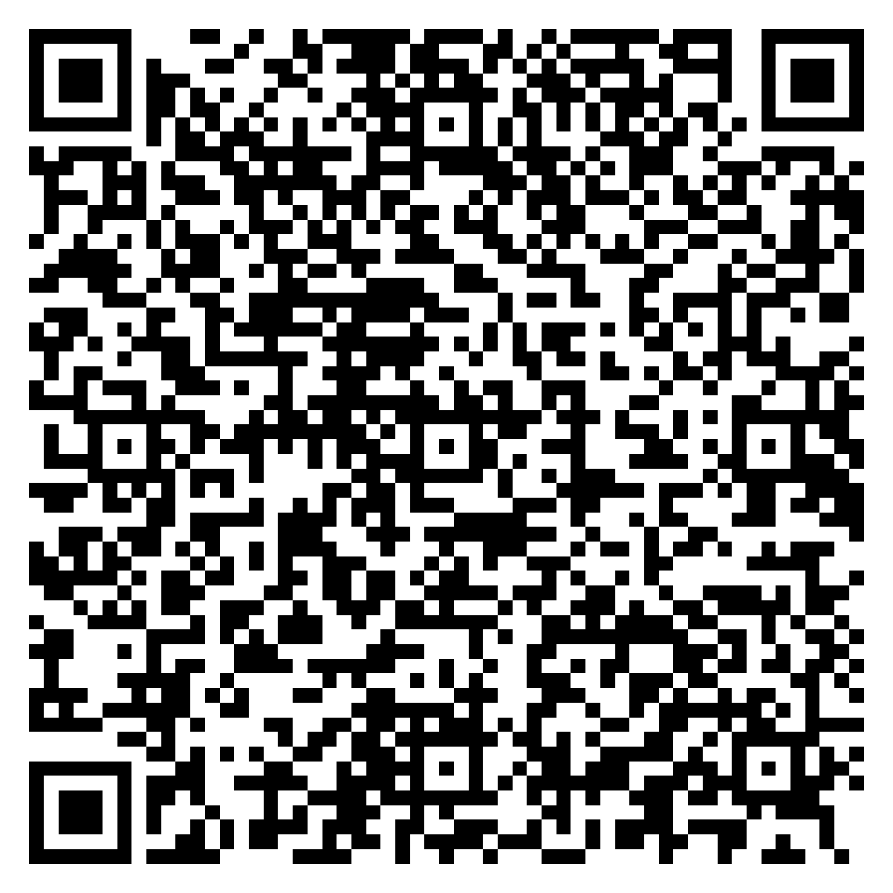
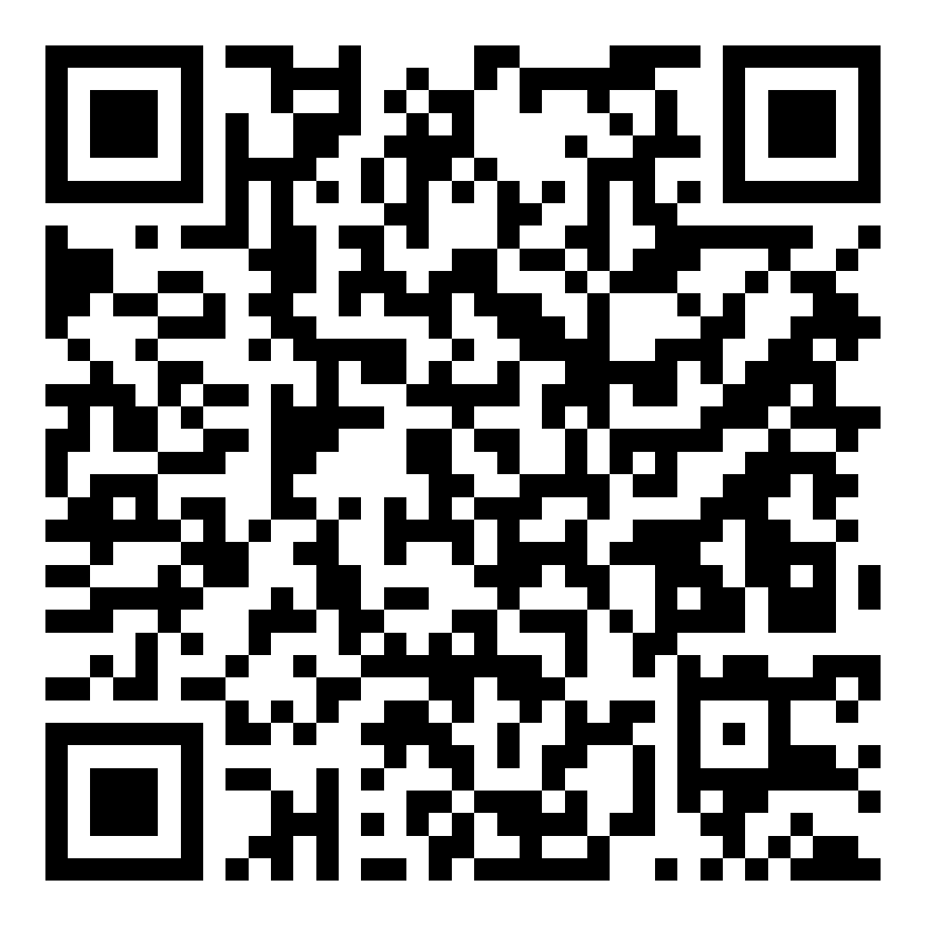
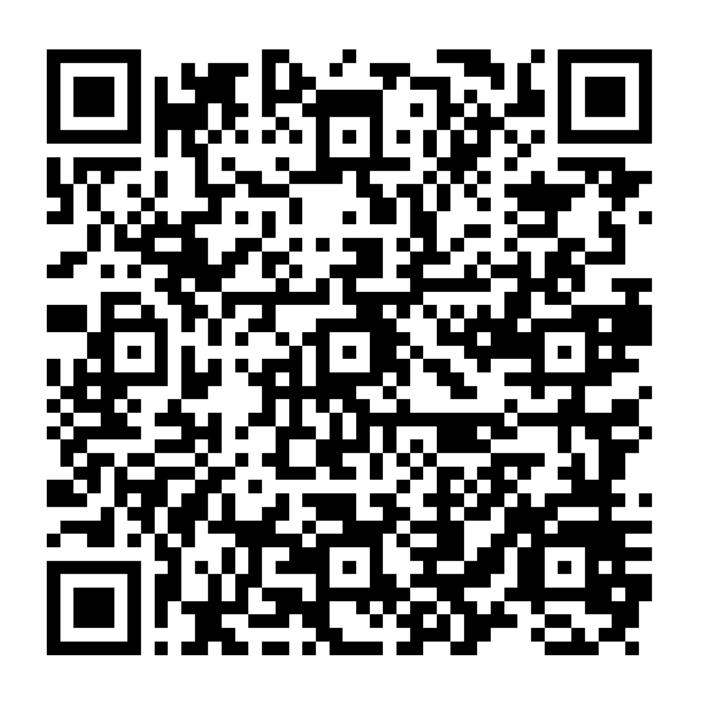
Bill Status
SUPPORT Reauthorization Act
Vehicle Bill for the FASD Respect Act (Section 210) in the Senate
Added language: HHS Secretary may require state and tribal grantees to designate state and tribal coordinators and the description of an advisory committee to develop guidelines to implement a state or tribal strategic plan.
HELP Ranking Senator Cassidy (R-LA) has included in his priority marker bill.
Authorization for the act expires Sept. 30th
Companion bill in the House has already gone through committee
Large effort in both House and Senate by Leg. Champions
Government Shut Down
Senate HELP Press Release
Bill Section by Section
Follow the Senate Bill S2433

Slide 10
Such Sums
Such Sums

Slide 11
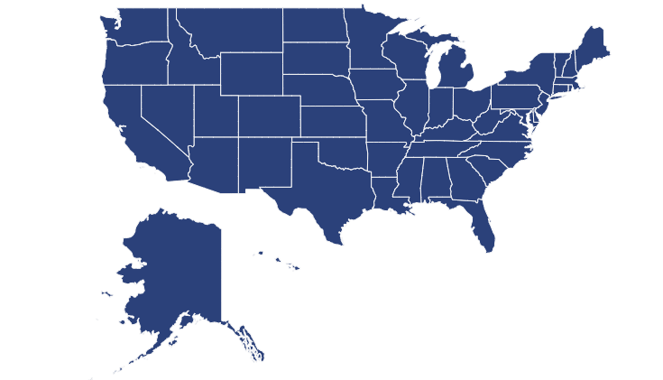
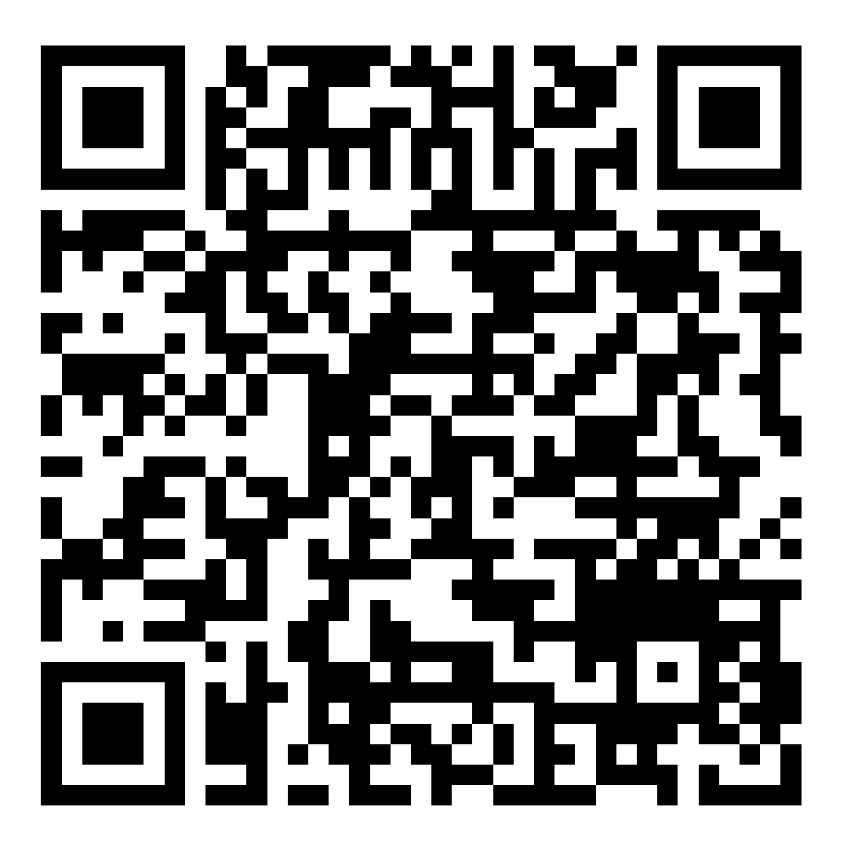
What do we do now?
DC
Follow up on Impact Week and Hill Day
In your State
Book legislator meetings – Special Focus on House E&C Health Subcommittee
Keep focused on The FASD Respect Act – not the Support Act…yet
FASD United will support your meetings. Contact Chris Melfi (Melfi@fasdunited.org) to book time with Chris, Susan Carlson, and Jenn to support your calls.
Get Endorsements for the Bill
House Health Subcommittee Members

Slide 12
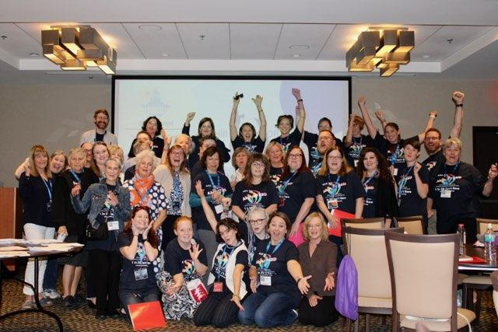

Slide 13
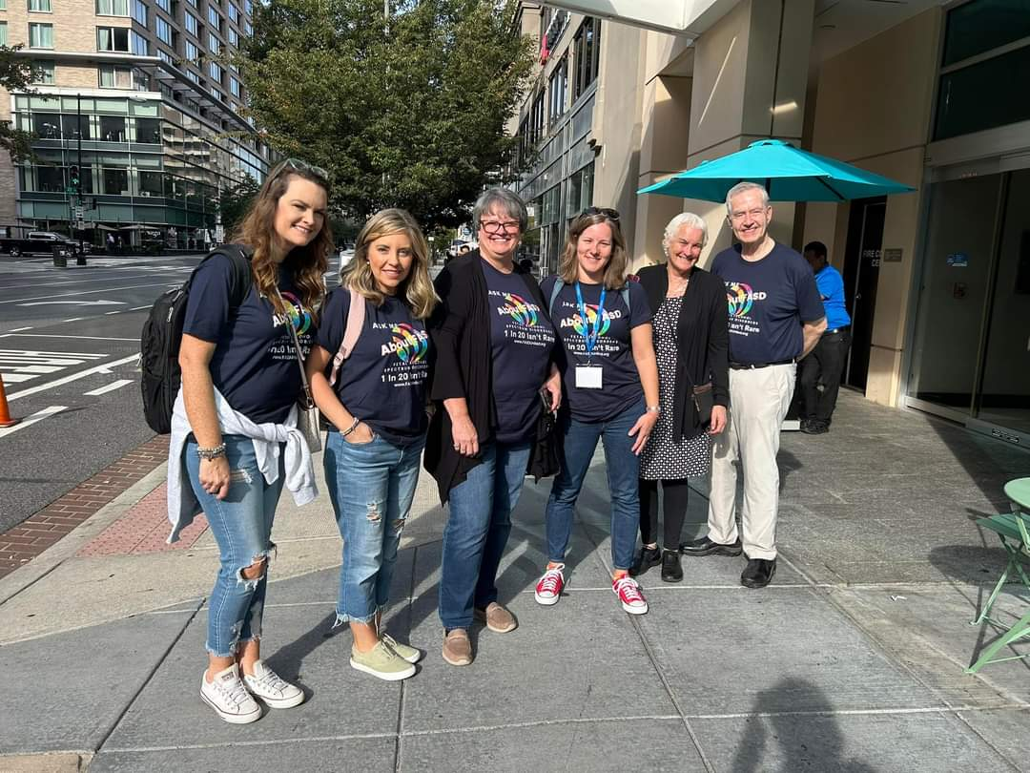

Slide 14
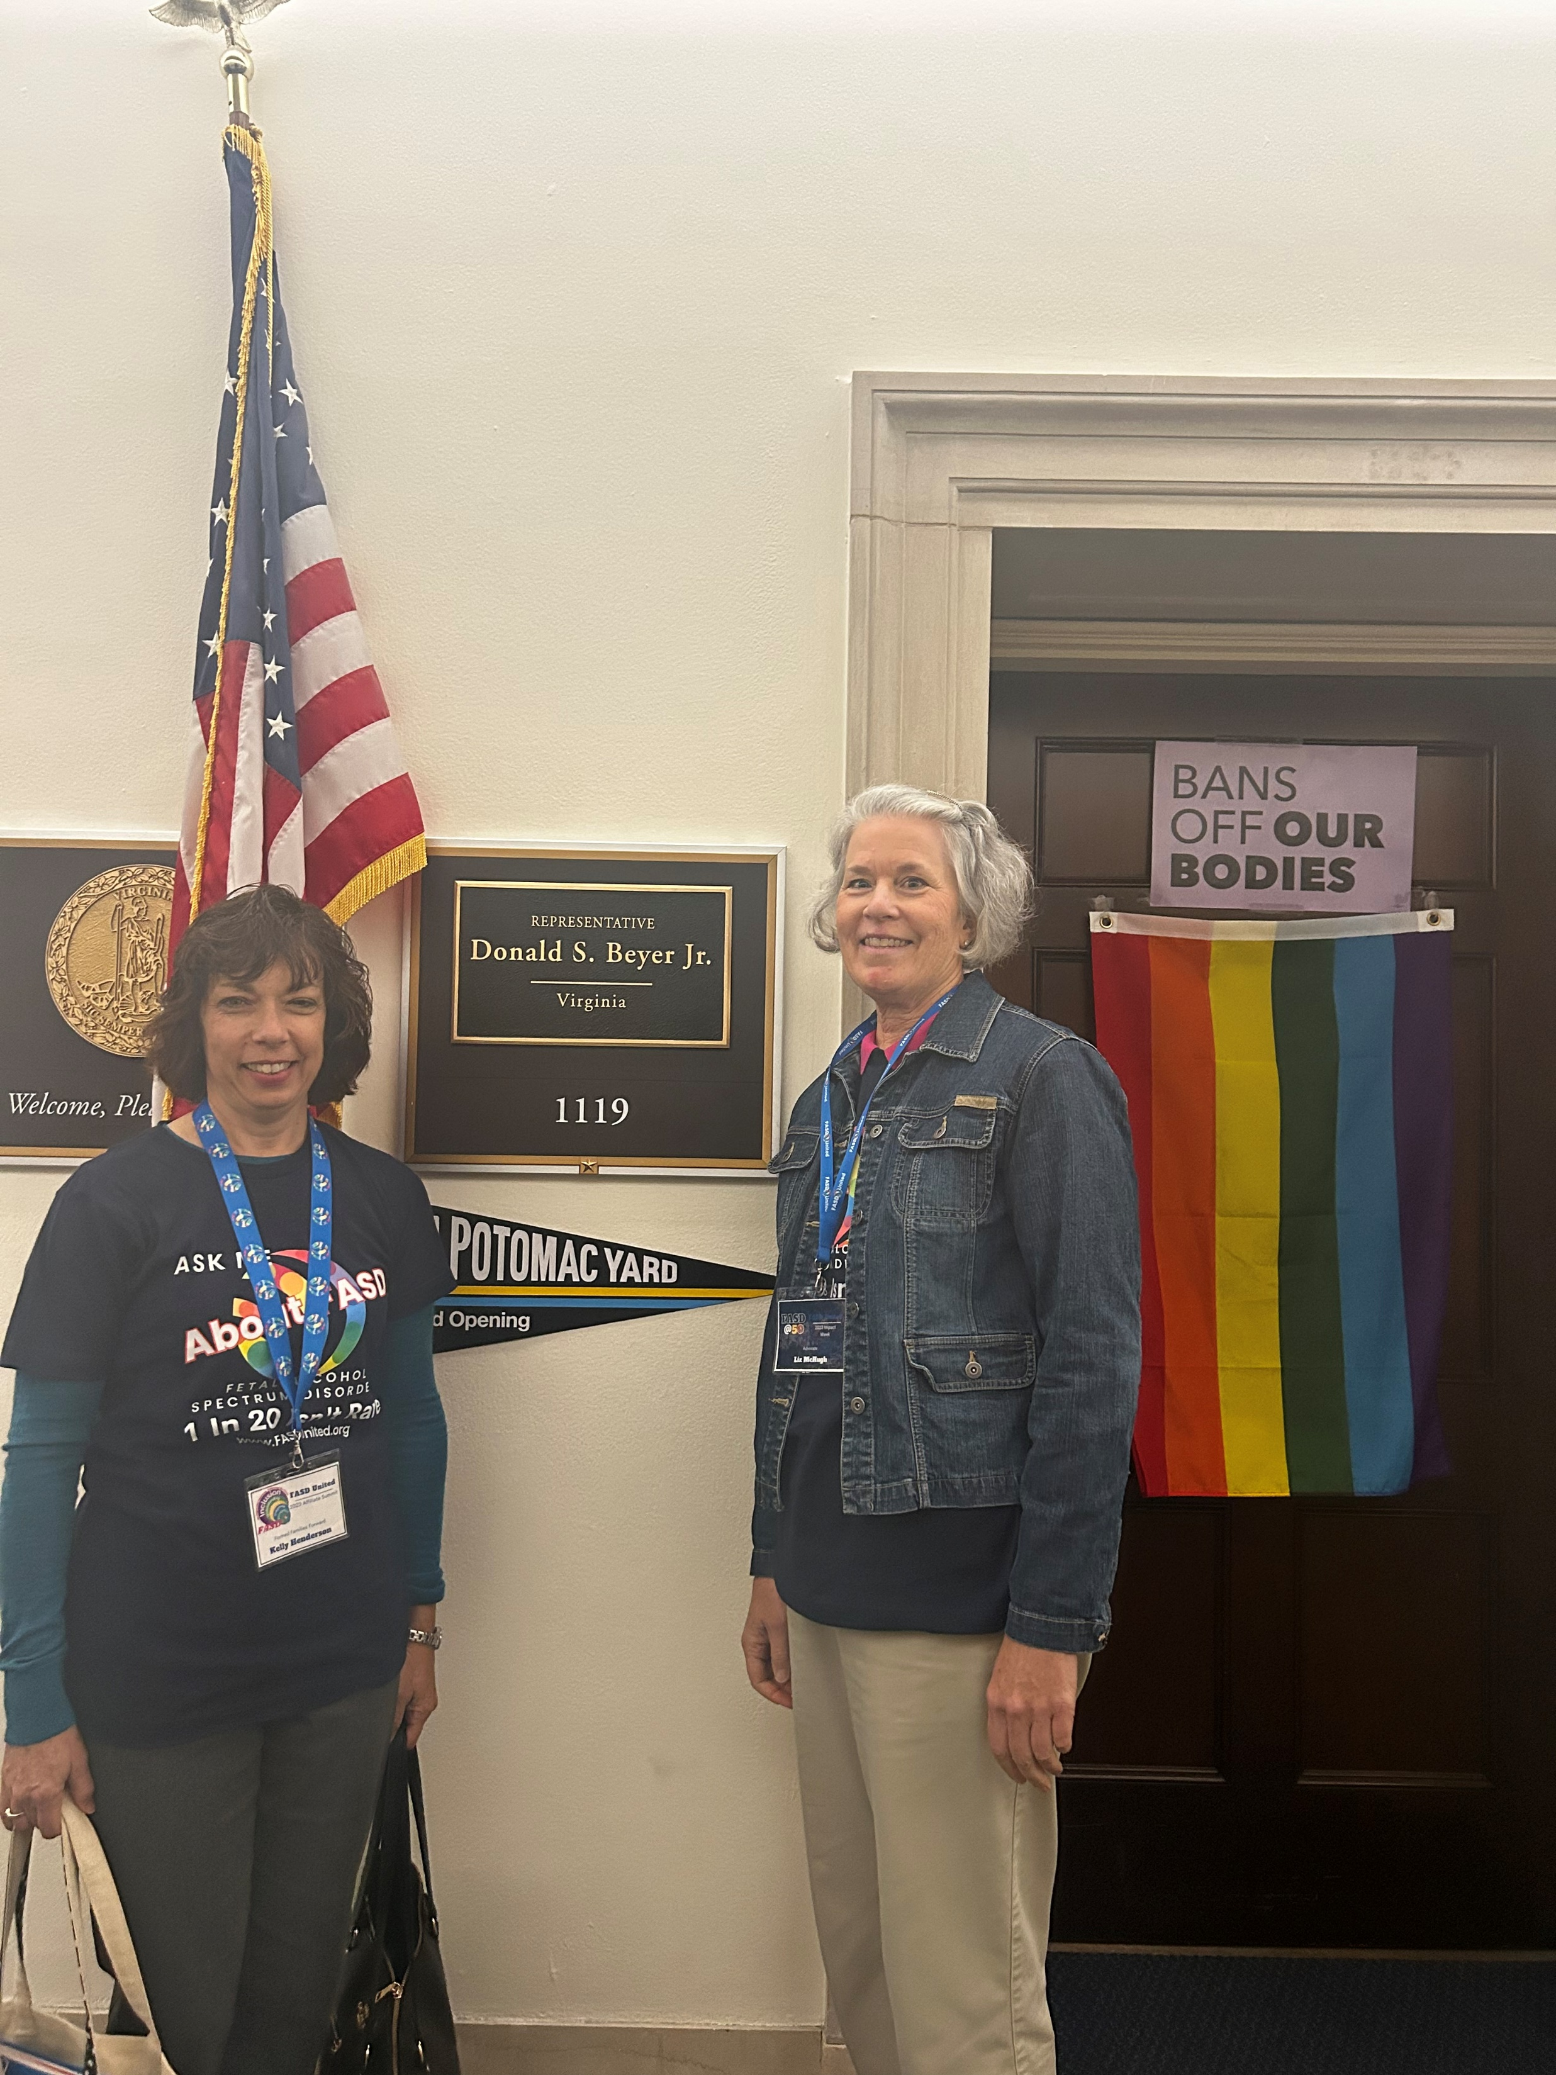

Slide 15
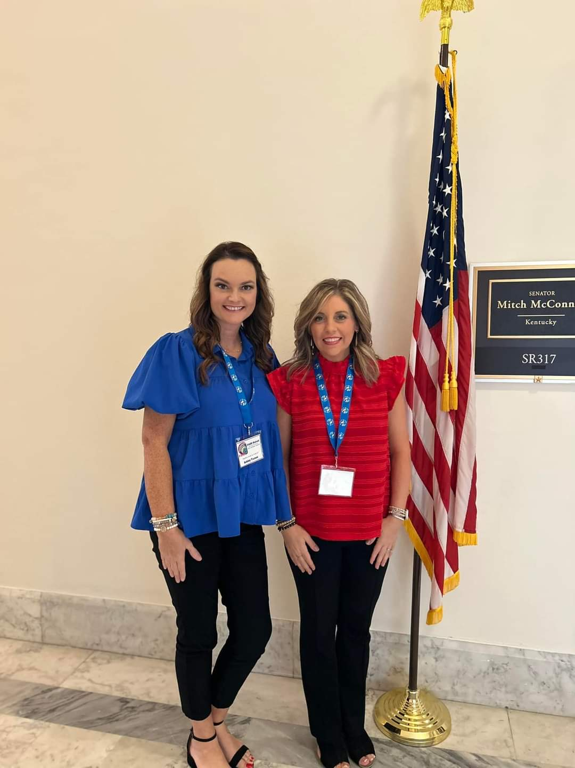

Slide 16
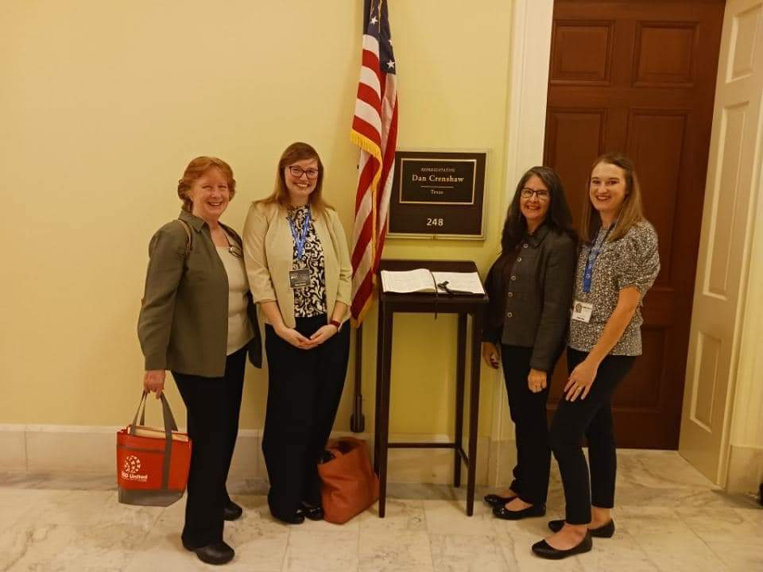

Slide 17
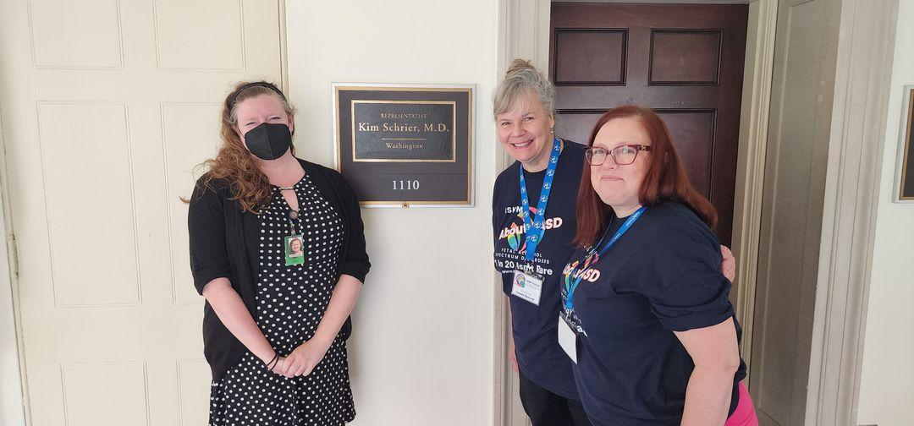

Slide 18
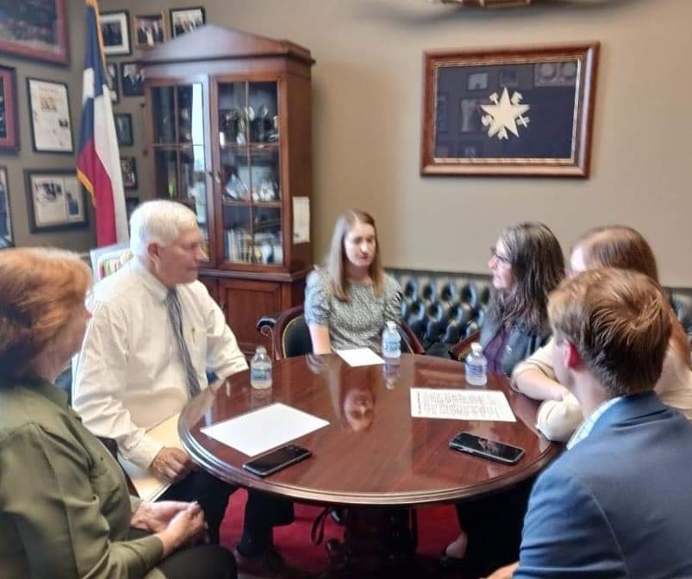

Slide 19
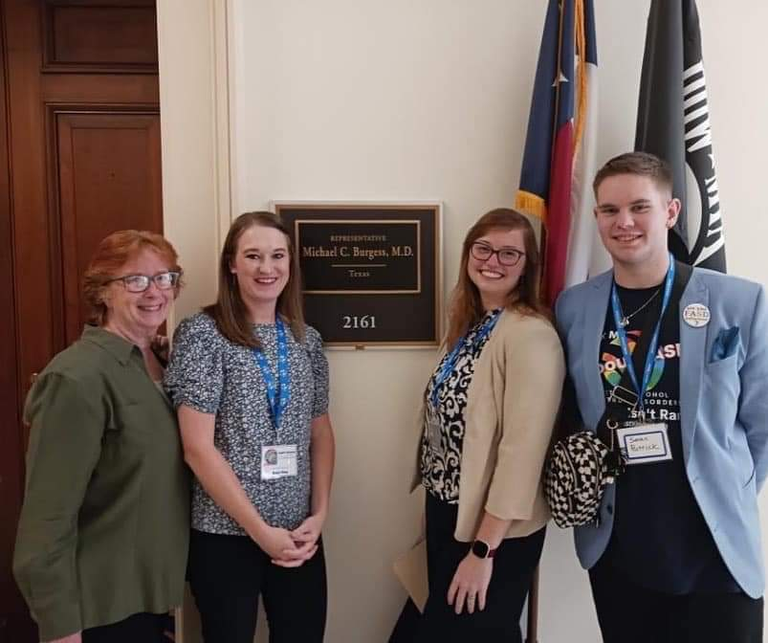

Slide 21
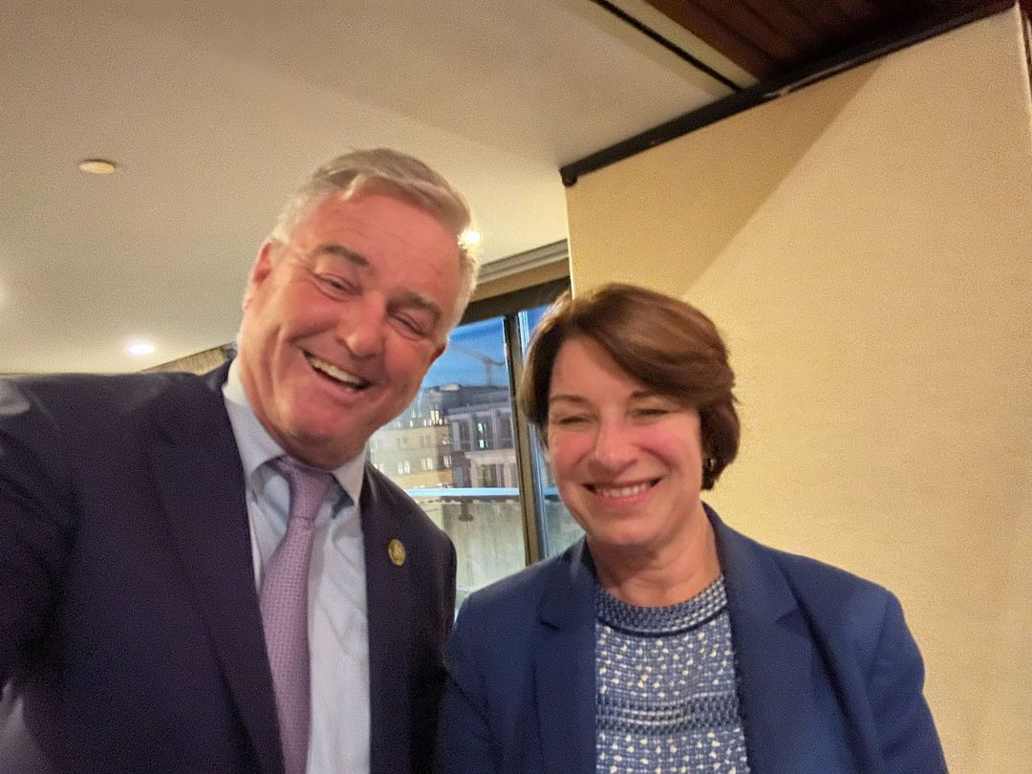

Slide 22
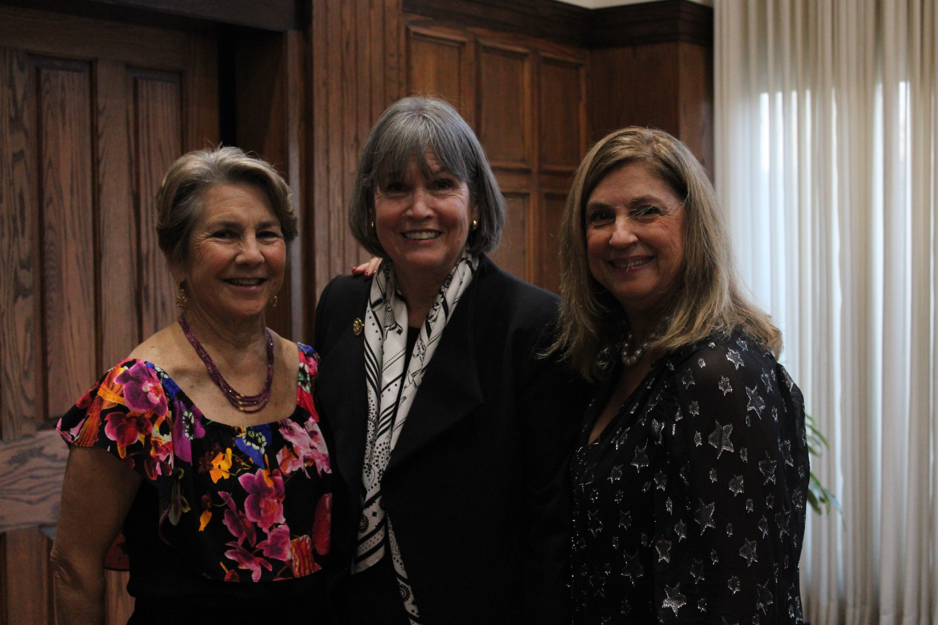

Slide 23
Hill Day 2023 Recap
72 Advocates
21 States, plus DC and Canada
60 Meetings
Spanning 21 States
16 Senators/ 44 Representatives
Impact So Far
Sen. Susan Collins [R-ME]
Rep. Joseph Morelle [D-NY-25]
Rep. Kim Schrier [D-WA-9]
Rep. Ted Lieu [D-CA-36]
Rep. Sessions (TX – Verbal)
Following Up…

Slide 24
Following Up After Your Meeting
Dear [Staffer or Congressperson’s Name],
Thank you for taking the time to meet with me recently regarding [S. 1800/HR. 3946] The FASD Respect Act and the positive effect it could have on [State]. As we discussed, FASD impacts 1 in 20 students and is often misdiagnosed or underdiagnosed, which can lead to further adverse outcomes for individuals and families [or other brief details on what you discussed]. This bipartisan, comprehensive legislation will help those individuals and families impacted by the disability.
If you would like more information on [S. 1800/HR. 3946] The FASD Respect Act you can use the link below, which will take you to FASD United’s Legislative Staffer Resources page. Thank you, again, for meeting with me and for considering co-sponsorship of this bill.
The FASD Respect Act – for Legislative Staffers – FASD United Policy And Training Center (nofaspolicycenter.org)
Sincerely,
[Name]

Slide 25
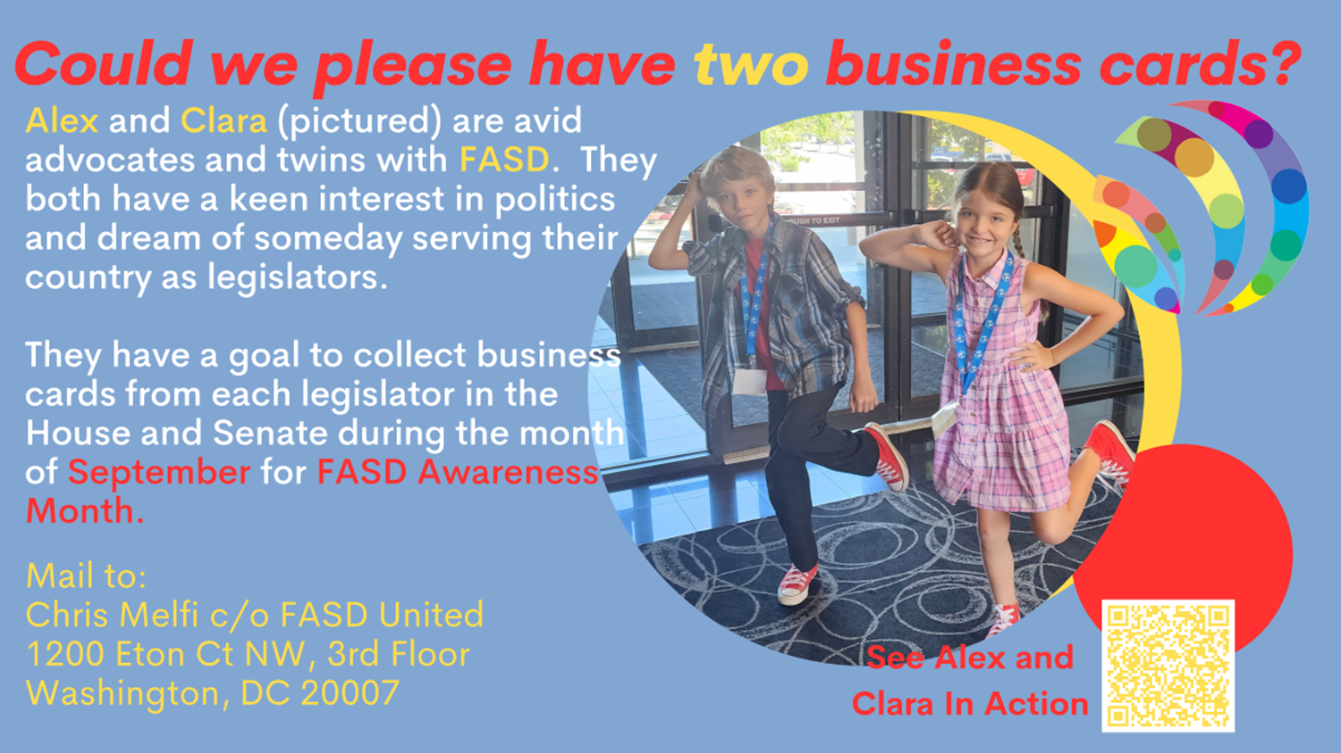

Slide 26
What’s Happened in September
New Co-Sponsors
Sen. Cramer, Kevin [R-ND]
Sen. Collins, Susan M. [R-ME]
Rep. Cárdenas, Tony [D-CA-29]
Rep. Bishop, Sanford D., Jr. [D-GA-2]
Rep. Green, Al [D-TX-9]
Rep. Lawler, Michael [R-NY-17]
Rep. Tonko, Paul [D-NY-20]
Rep. Connolly, Gerald E. [D-VA-11]
Rep. Higgins, Brian [D-NY-26]
Rep. Golden, Jared F. [D-ME-2]
Rep. Rutherford, John H. [R-FL-5]
Rep. Johnson, Henry C. "Hank," Jr. [D-GA-4]
Rep. Morelle, Joseph D. [D-NY-25]
Rep. Schrier, Kim [D-WA-8]
Rep. Lieu, Ted [D-CA-36]

Slide 27
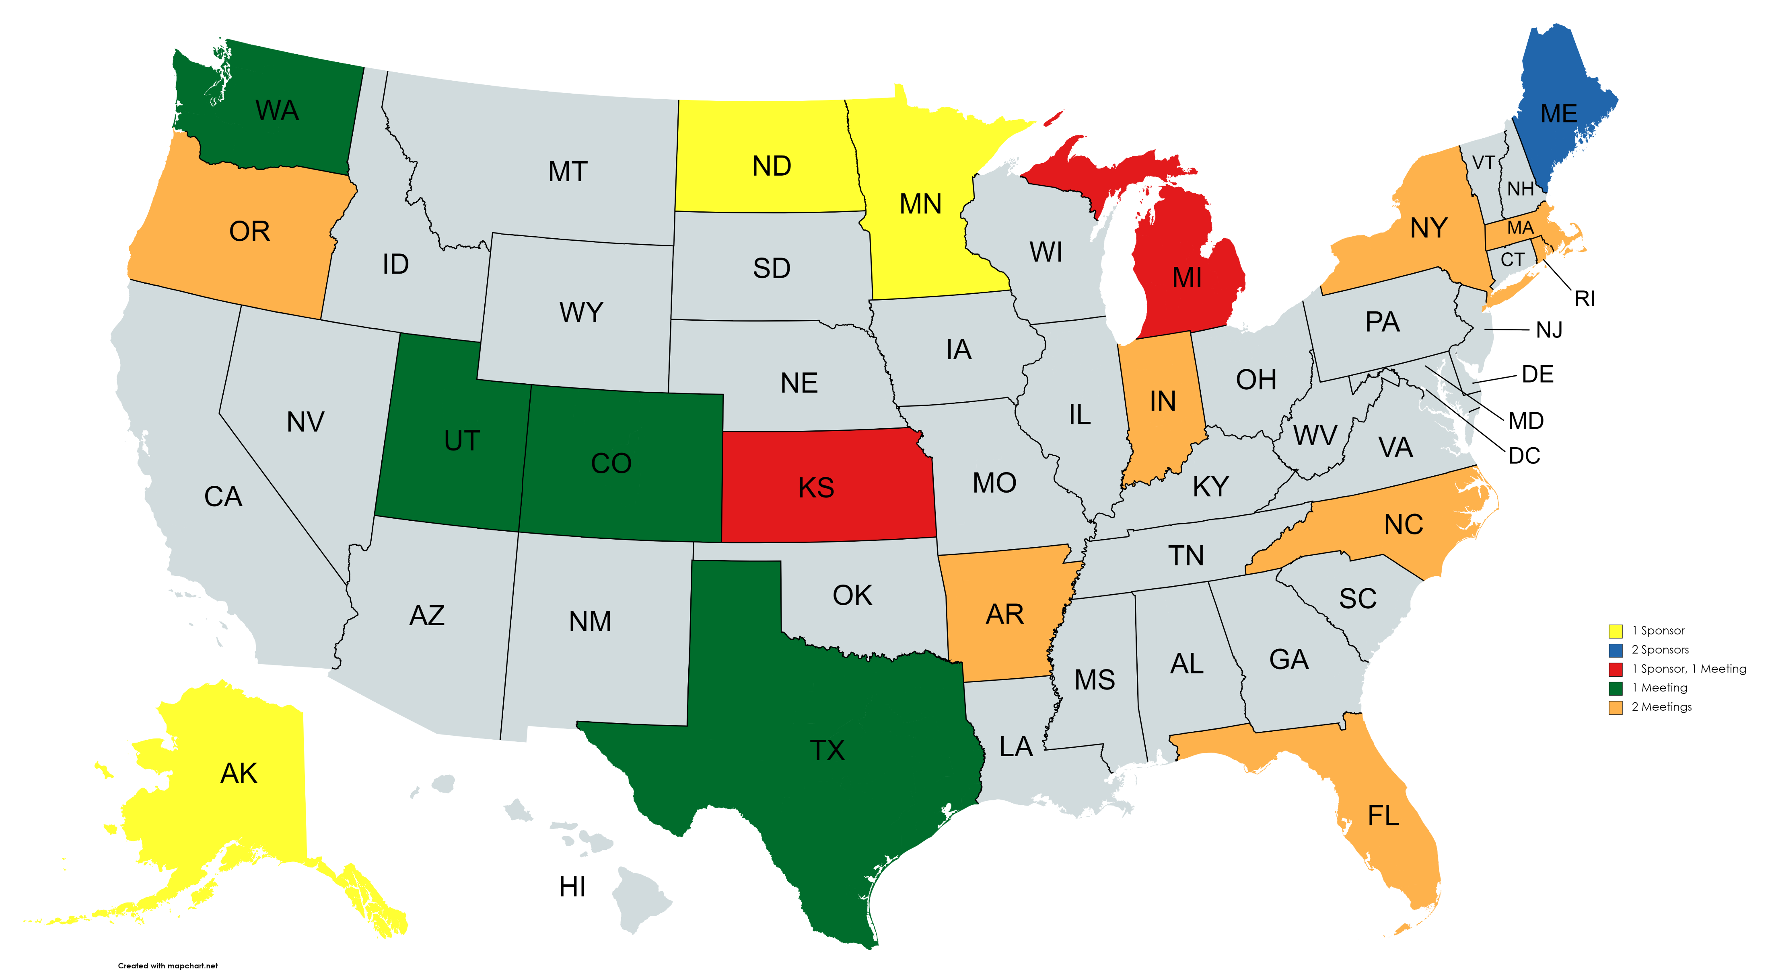
Senate Meetings and Sponsors

Slide 28
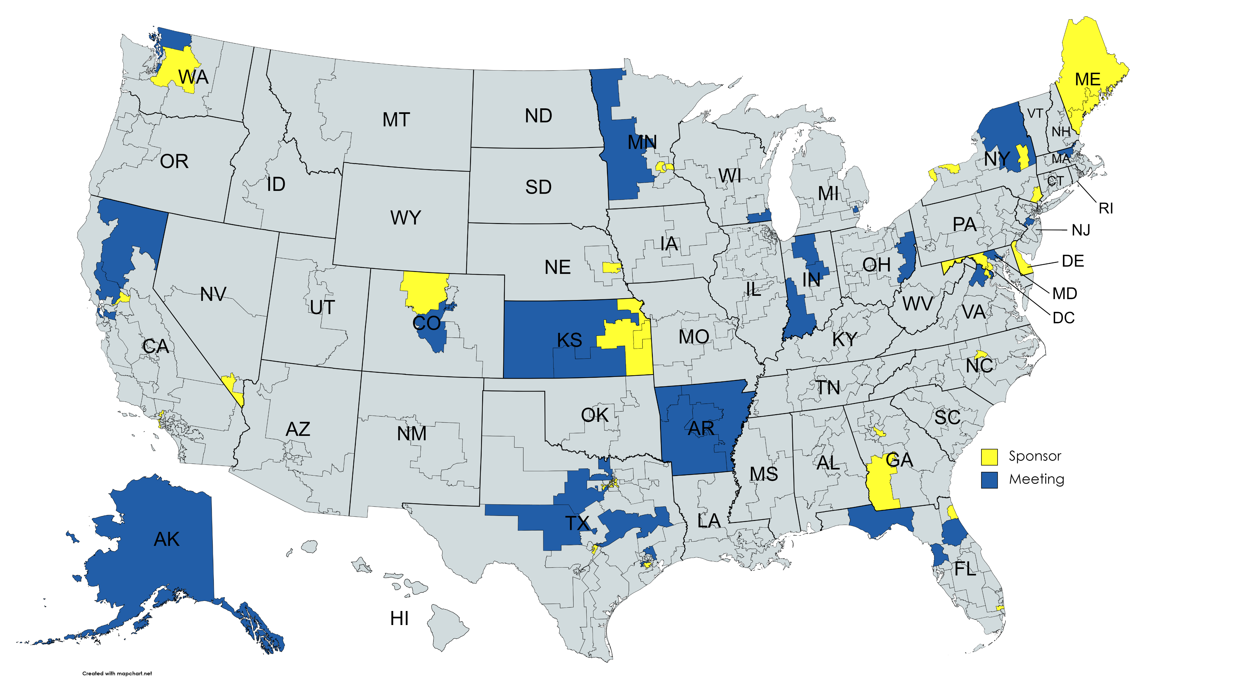
House Meetings and Sponsors

Slide 29
Documents To Send Available on “Staffers Resources”
Everybody | Previous Co-Sponsors
Bill Text send as a link to congress.gov* | FASD Respect Act 117th Congress Comparison to HR4151/S2238*
Summary and Rationale*
National Agenda*
State Data Sheet (Available on State Pages)*
Optional Documents:
History of FASD Program Authorizations and Funding*
Bill Incorporated into Federal Code*
Bill One Pager*
FASD and Child Welfare Report
TEP Report
*New or Updated Documents

Slide 30
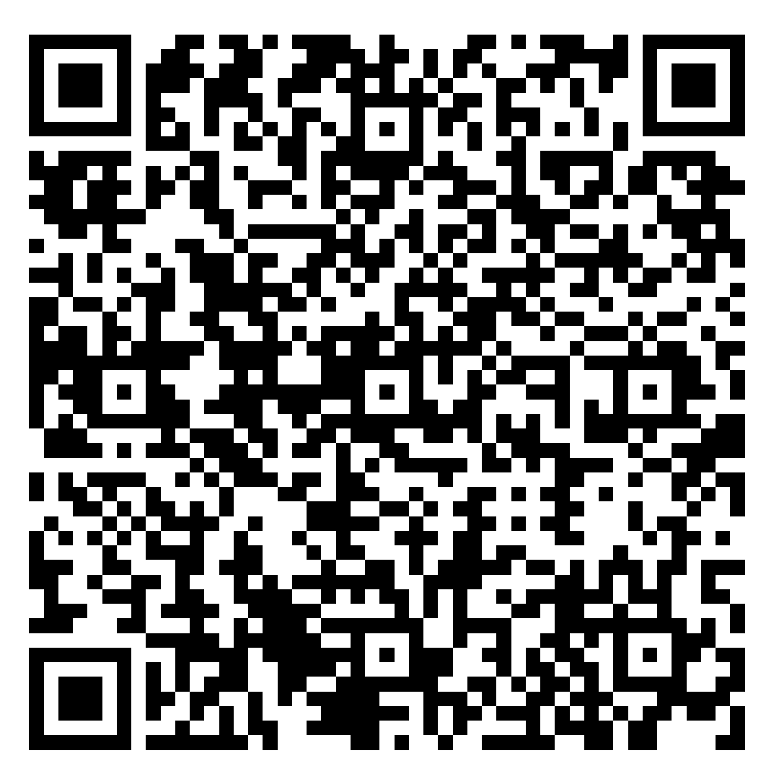
Organization Support
Sign on Letter now available!
https://nofaspolicycenter.org/organizations/
Remember – this is a sign on letter for companies, organizations or agencies, NOT individuals.
View a current list here:

Slide 31
Together, we can do this.

