Slide 1
FASD United
July 2022
Policy Forum
Policy & Training Center
Program Contact: Jenn Wisdahl
wisdahl@FASDUnited.org
202-601-2530
Wednesday
July 27, 2022

Slide 2
Organization Update
Tom Donaldson, President

Slide 3
Community Calendar
Stars for Starla Art Contest www.bit.ly/FASDArtContest
How are You Celebrating In September?

Slide 4
A Virtual 5k

Slide 5
A virtual 5k event that can happen at your own pace wherever you are. From September 9th-25th, 2022, Run FASD to bring awareness to Fetal Alcohol Spectrum Disorders.

Slide 6
Full Registration: $35 (shirt, medal & race bib)
Shirt & Bib Only: $20
Medal Only: $15
Race Bib: $5

Slide 7
Run FASD 2021 came on the scene with a splash. 249 registered runners, with over 300 participants in North America, this year our goal is to hit over 500 registered runners.

Slide 9
Affiliate Update
Program Contact:
Susan Elsworth
elsworth@FASDUnited.org
(202) 601-2527

Slide 10
State Legislation Updates

Slide 11
State Legislation Updates
California
New York
What are your legislative priorities in your state next year? How could your state respond to the Respect Act?

Slide 12
Recent Federal Updates

Slide 13
Senate announced intent to focus on appropriations prior to August Recess
Looking for $2mil increase at CDC for FASD Programs

Slide 15
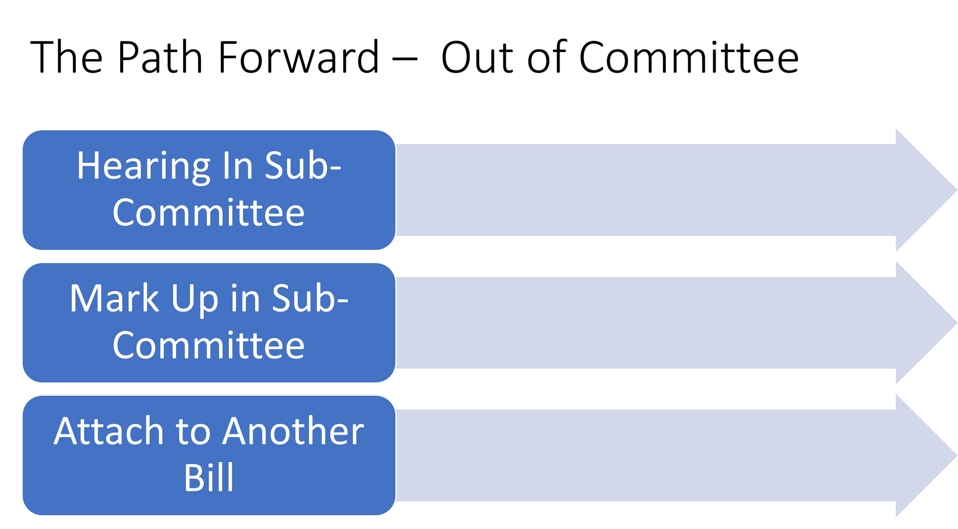
The FASD Respect Act
The Path Forward
Sail into September
Session Ends
January 2023
July 2022

Slide 16
The FASD Respect Act
The Path Forward
Sail into September
Session Ends
January 2023
Letter from Betty McCollum signed by all House E&C Co-Sponsor Members going to Eshoo & Pallone and ranking members McMorris-Rodgers and Guthrie, requesting consideration
Potential R Co-sponsor on committee in progress
July 2022

Slide 17
The FASD Respect Act
The Path Forward
Sail into September
Session Ends
January 2023
Meetings with Murray and Burr’s staff.
Letter to Senators Burr and Murray (HELP Committee Ranking/Chair) asking for consideration or S2238.
Positive response received.
July 2022

Slide 18
The FASD Respect Act
The Path Forward
Sail into September
Session Ends
January 2023
HR5551 – Passed the house and is now in the Senate, updates CDC language from FAS to FASD. Provided additional authorization language for expanded CDC Programs on FASD.
HR7666 – Passed the house and is in the Senate. Mental health and substance use disorders package. Provided language to insert “FASD informed” and provisions from HR4151/S2238 relating to MH and SUD.
July 2022

Slide 19
Current Events and Impact on FASD Policy
Nicholas Cruz Trial
Review the response posted on the FASD United Website (scroll down to bottom of home page under News)
Be aware of the impact statements from the FASD community could have on legislation

Slide 20
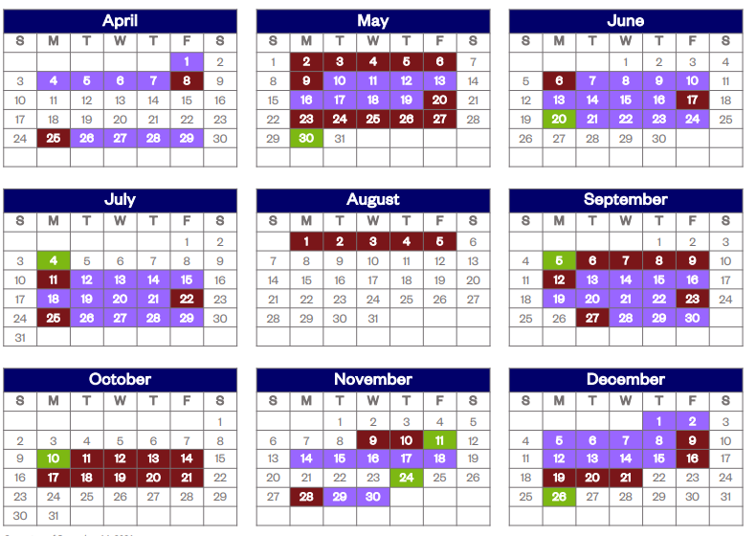
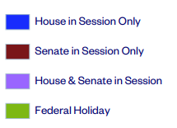
House and Senate Calendar 2022

Slide 21
August Action Items
Attend Town Halls or key campaign events (www.townhallproject.com )
Awareness Month Proclamations (https://nofaspolicycenter.org/how-to-issue-an-fasd-awareness-month-proclamation/ )
Set Meetings with lawmakers we’ve already met with who haven’t co-sponsored
Build endorsements https://nofaspolicycenter.org/organizations/
Social Media (https://nofaspolicycenter.org/the-fasd-respect-act/fasdrespect-socialmedia/ )

Slide 22
Key Meetings Still Needed
House Energy and Commerce Health Subcommittee:
CA – Matsui (D)
FL – Bilirakis (R)*
IN – Buchon (R)
MD – Sarbanes (D)
MO – Long (R)
NH – Kuster (D)
OK – Mullin (R)
OR – Schrader (D)
PA – Joyce (R)
VA – Griffith (R)
Senate HELP Committee:
AL – Shelby
LA – Cassidy
NH – Hassan
NM – Lujan

Slide 23
Anna Eshoo CA D 18
Doris Matsui CA D 6
Nanette Barragan CA D 44
Raul Ruiz CA D 36
Tony Cardenas CA D 29
Lisa Blunt Rochester* DE D At-large
Gus Bilirakis FL R 12
Kathy Castor FL D 14*
Neal Dunn FL R 2
Buddy Carter GA R 1
Robin Kelly IL D 2
Larry Bucshon IN R 8
Brett Guthrie KY R 2
Lori Trahan MA D 3
John Sarbanes MD D 3
Debbie Dingell MI D 12
Fred Upton MI R 6
Angie Craig* MN D 2
Billy Long MO R 7
G.K. Butterfield NC D 1
Richard Hudson NC R 8
Ann McLane Kuster NH D 2
Frank Pallone NJ D 6
Markwayne Mullin OK R 2
Kurt Schrader OR D 5
John Joyce PA R 13
Dan Crenshaw TX R 2
Lizzie Fletcher TX D 7
Michael Burgess TX R 26
John Curtis UT R 3
Morgan Griffith VA R 9
Peter Welch VT D At Large
Cathy McMorris Rodgers** WA R 5
Kim Schrier* WA D 8
House Energy and Commerce Health Sub-Committee
Meetings Held
Meeting Held
Key Meeting Held
Co-Sponsor

Slide 24
A Rising Tide of Co-Sponsors
March/April
Added
9 House
Jan/Feb
Added
12 House
2 Senate
Nov/Dec Added
8 House
May/June added 13 House
Sept/Oct Added
7 House
3 Senate
July/August Added
3 House
2 Senate
July
Added
6 House
June
Introduced
2 House
2 Senate
60 in the House
9 in the Senate

Slide 25
Current
Senate Sponsors
Senator Lisa Murkowski (R AK)*
Senator Amy Klobuchar (D MN)
Senator Jerry Moran (R KS)*
Senator Tina Smith (D MN)*
Senator Susan Collins (R ME)*
Senator Brian Schatz (D HI)
Senator Angus King (I ME)
Sen. Shelley Moore Capito [R-WV]
Sen. Mazie Hirono [D-HI]
*Sits on Committee of Jurisdiction

Slide 26
Rep. Levin, Mike [D-CA-49]
Rep. Panetta, Jimmy [D-CA-20]
Rep. Brownley, Julia [D-CA-26]
Rep. Phillips, Dean [D-MN-3]
Rep. Jayapal, Pramila [D-WA-7]
Rep. Bacon, Don [R-NE-2]
Rep. Castor, Kathy [D-FL-14]
Rep. Underwood, Lauren [D-IL-14]
Rep. Delgado, Antonio [D-NY-19]
Rep. Rutherford, John H. [R-FL-4]
Rep. Adams, Alma S. [D-NC-12]
Rep. Garamendi, John [D-CA-3]
Rep. Morelle, Joseph D. [D-NY-25]
Rep. Butterfield, G. K. [D-NC-1]
Rep. Cardenas, Tony [D-CA-29]
Rep. Sanchez, Linda [D-CA-38]
Rep. Welch, Peter [D-VT-At Large]
Rep. Huffman, Jared [D-CA-2]
Rep. Napolitano, Grace F. [D-CA-32]
Rep. Aguilar, Pete [D-CA-31]
Rep. Jacobs, Sara [D-CA-53]
Rep. Wexton, Jennifer [D-VA-10]
Rep Takano, Mark [D-CA-41]
Rep. Carbajal, Salud O. [D-CA-24]
Rep. Porter, Katie [D-CA-45]
Rep. Lieu, Ted [D-CA-33]
Rep. Gottheimer, Josh [D-NJ-5]
Rep. Higgins, Brian [D-NY-26]
**Rep. Johnson, Henry C Jr. [D-GA-4]
**Rep. Connolly, Gerald [VA-11]
Rep. McCollum, Betty [D-MN-4]
Rep. Young, Don [R-AK-At Large]
Rep. Omar, Ilhan [D-MN-5]
Rep. Bishop, Sanford D., Jr. [D-GA-2]
Rep. Jackson Lee, Sheila [D-TX-18]
Rep. Mann, Tracey [R-KS-1]
Rep. Pingree, Chellie [D-ME-1]
Rep. Davids, Sharice [D-KS-3]
Rep. Craig, Angie [D-MN-2]
Rep. Kilmer, Derek [D-WA-6]
Rep. Wild, Susan [D-PA-7]
Rep. Kahele, Kaiali'i [D-HI-2]
Rep. Case, Ed [D-HI-1]
Rep. Raskin, Jamie [D-MD-8]
Rep. Bourdeaux, Carolyn [D-GA-7]
Rep. Lee, Barbara [D-CA-13]
Rep. Huizenga, Bill [R-MI-2]
Rep. Ross, Deborah K. [D-NC-2
Rep. Thompson, Mike [D-CA-5]
Rep. Costa, Jim [D-CA-16]
Rep. Lucille Roybal-Allard [D-CA-40]
Rep. Jared Golden [D-ME-2]
Rep. Kim Schrier [D-WA-8]
Rep. Eric Swalwell [D-CA-15]
Rep. David Trone [D-MD-6]
Rep. Liz Cheney [R-WY-At Large]
Rep. Lisa Blunt Rochester [D-DE-At Large]
Rep. Lofgren, Zoe [D-CA-19]
Rep. Emmer, Tom [R-MN-6]
Rep. Beyer, Donald S., Jr. [D-VA-8]
Rep. Doggett, Lloyd [D-TX-35]
Rep. Chu, Judy [D-CA-27]
Rep. Tonko, Paul [D-NY-20]
Current
House
Bill Sponsors
*Sits on Committee of Jurisdiction
**Pending Updates to Congress.gov

Slide 27
July
Meetings
House Meetings
Rep. Olbernote (CA-8)
Rep. Carbajal (CA-24)
Rep. Connolly (VA-11)
Rep. Porter (CA-45)
Rep. McClintock (CA-4)
Rep. Carter (GA-1)*
Rep. Vargas (CA-51)
Rep. McCaul (TX-10)
Senate Meetings
Sen. Murray (WA)*
Sen. Graham (SC)
Sen. Grassley (IA)
Sen. Kaine (VA)*
Sen. Scott (SC)*
Overall :
House – 162 (out of 436)
Senate – 53 (out of 100)
Note, we’ve met with some Senators & Reps more than 3 times

Slide 28
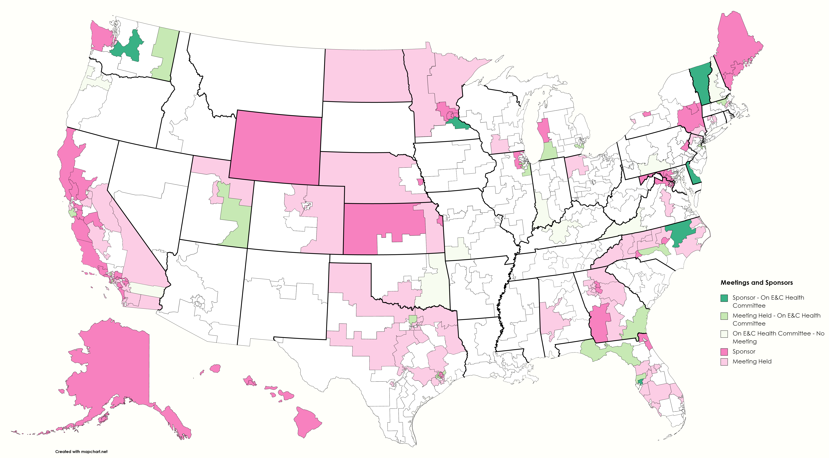
House

Slide 29
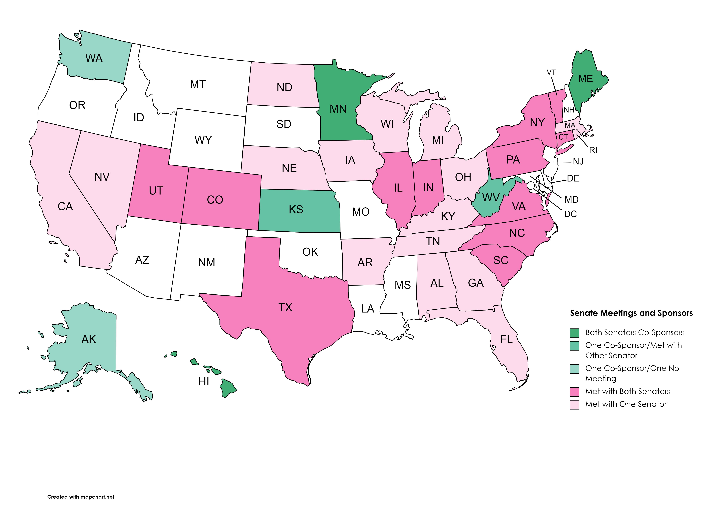
Senate

Slide 30
23 New July Endorsements
www.nofaspolicycenter.org/organizations

Slide 31
What’s Next
Look for a poll on legislative priorities for the 118th Congress

Slide 32
FASD United
Policy & Training Center
Together, We Can Do This.

